Slide 1
Nonparametric tests:
Tests without population parameters
(means and standard deviations)

Slide 2
Step One: Rank all data across groups
group 1 group 2
24 28
18 2 42
45 63
57 57
12 1 90
30 68

Slide 3
group 1 group 2
24 3 28 4
18 2 42
45 63
57 57
12 1 90
30 68

Slide 4
group 1 group 2
24 3 28 4
18 2 42 6
45 7 63
57 57
12 1 90
30 5 68

Slide 5
Tied ranks:
Find all values that are tied.
Identify all ranks that would be assigned to those values.
Average those ranks.
Assign that average to all tied values.

Slide 6
group 1 group 2
24 3 28 4
18 2 42 6
45 7 63
57 57
12 1 90
30 5 68

Slide 7
8th and 9th ranks would be used.
8+9 = 17 Averaging
17/ 2 = 8.5 ranks

Slide 8
group 1 group 2
24 3 28 4
18 2 42 6
45 7 63
57 8.5 57 8.5
12 1 90
30 5 68

Slide 9
group 1 group 2
24 3 28 4
18 2 42 6
45 7 63 10
57 8.5 57 8.5
12 1 90 12
30 5 68 11

Slide 10
group 1 group 2
24 3 28 4
18 2 42 6
45 7 63 10
57 8.5 57 8.5
12 1 90 12
30 5 68 11
26.5 51.5
Step Two: Sum the ranks for each group

Slide 11
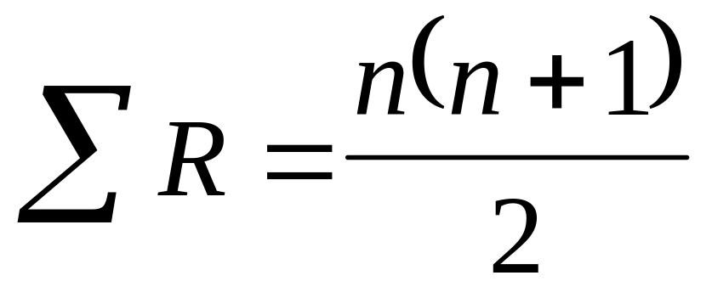
Check the rankings:

Slide 12
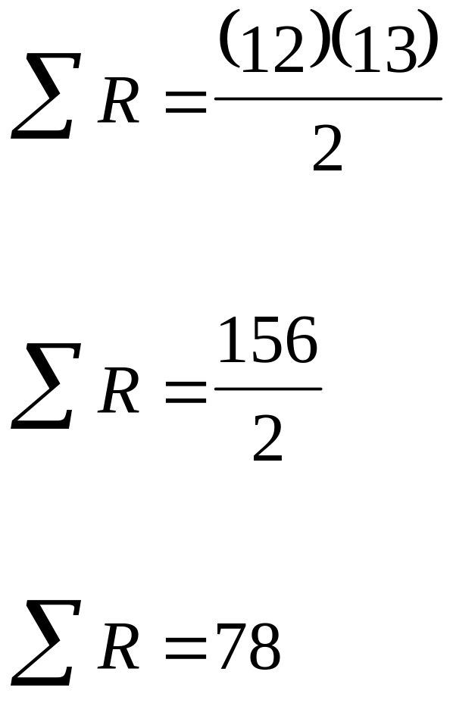

Slide 13
group 1 group 2
24 3 28 4
18 2 42 6
45 7 63 10
57 8.5 57 8.5
12 1 90 12
30 5 68 11
26.5 51.5

Slide 14
26.5 + 51.5 = 78

Slide 15
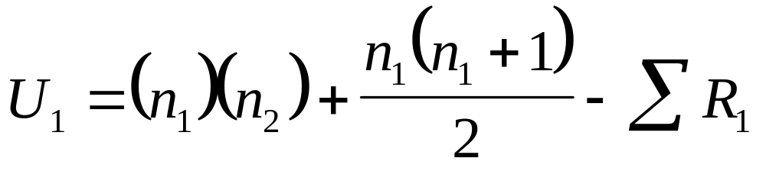
Step Three: Compute U₁

Slide 16
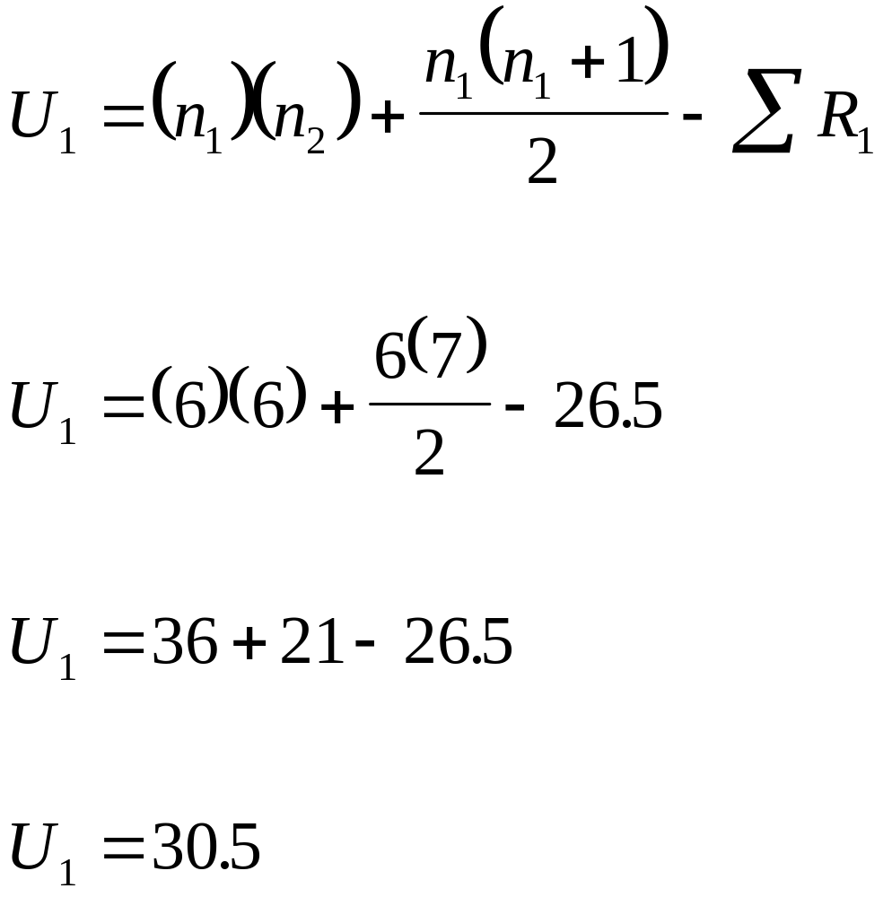

Slide 17
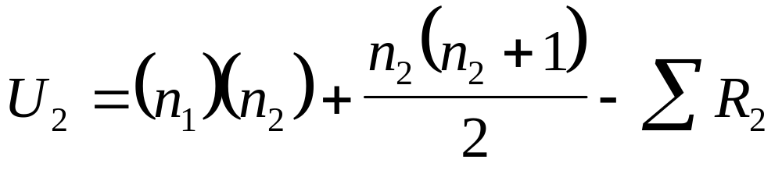
Step Four: Compute U₂

Slide 18
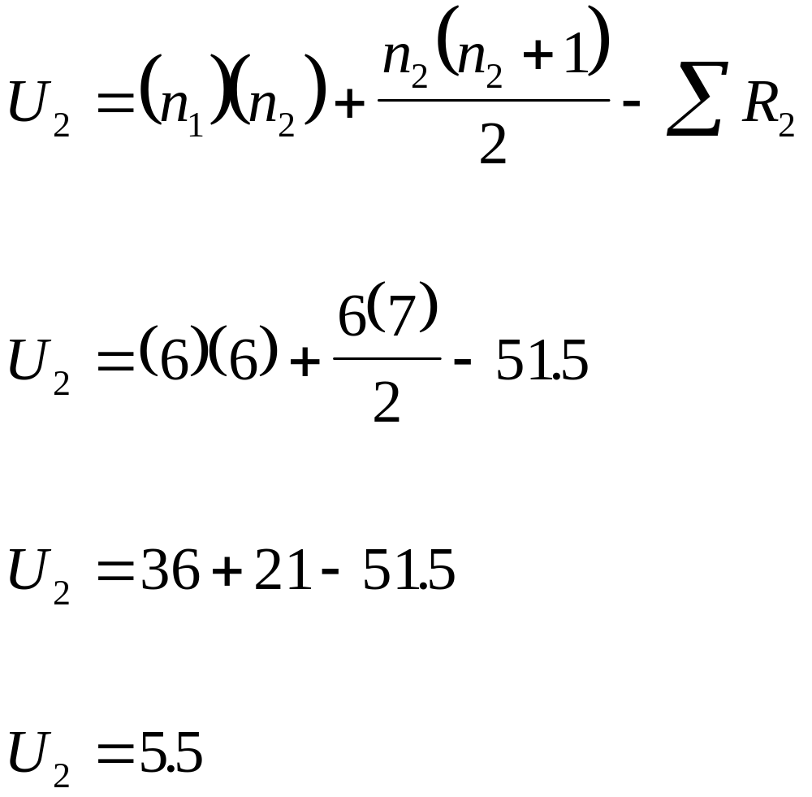

Slide 19
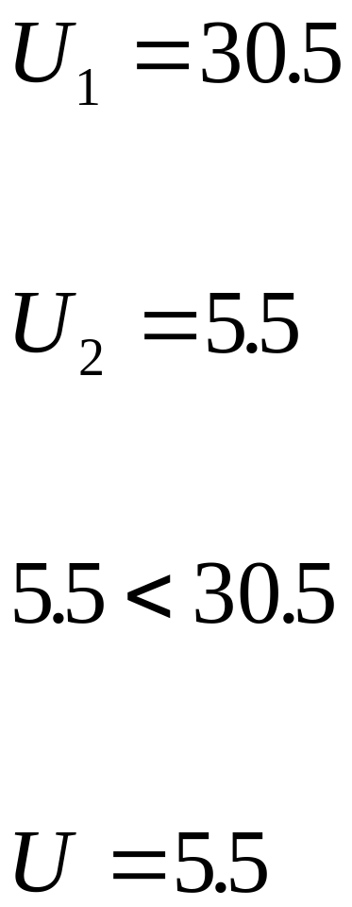
Step Five: Compare U₁ to U₂

Slide 20
Critical Value = 5
This is a non significant outcome

